Slide 1
Training material for architects
Health aspects of indoor air pollution in schools:
Specific actions aimed at reducing the health risks due to indoor pollutants
National Public Health Center

Slide 2
Outline
Indoor Air Quality
Factors influencing IAQ
Primary sources of IAQ contaminants
- Outdoor sources
- Indoor sources
Overview of air pollutants
Health impacts of indoor air pollution
Contribution of indoor air pollution to the disease burden
Sick Building Syndrome
Indoor Environmental Quality (IEQ)
Health impacts of climate change
Notes:
2

Slide 3
Why IAQ issues important in schools?
Children spend 90% of their time indoors (classrooms, homes, vehicles)
Studies have indicated that indoor air often contain higher levels of contaminants than outdoor air.
In Hungary there are 3585 primary schools with 735 thousands pupils. This is almost 10% of the population!
Number of teachers in primary schools: 78 thousand (in 2018).
Focus on Children’s Health and healthy environmental issues according to the European Environment and Health Process (WHO/Euro, UN ECE) has high priority.
Notes:
quote national data !
3

Slide 4
Children’s Health and Environment Action Plan for Europe
Children’s health and healthy environmental issues according to the European Environment and Health Process (WHO/Euro, UN/ECE) has gained a high priority.
In 2004, the Fourth Ministerial Conference on Environment and Health adopted the Children’s Health and Environment Action Plan for Europe, which includes four regional priority goals to reduce the burden of environment-related diseases in children (CEHAPE).
One of the goals (Regional Priority Goal, RPG III) aims to prevent and reduce respiratory diseases due to outdoor and indoor air pollution, thereby contributing to a reduction in the frequency of asthmatic attacks, and to ensure that children can live in an environment with clean air.
Source: http://www.euro.who.int/__data/assets/pdf_file/0006/78639/E83338.pdf

Slide 5
Indoor Air Quality (IAQ)
Indoor space: any closed area surrounded by boundary elements (including the indoor space of vehicles)
Indoor Air Quality refers to the quality of the air inside buildings as represented by concentrations of pollutants and thermal (temperature and relative humidity) conditions that affect the health, comfort, and performance of people staying inside.
Indoor air pollution does not include technology-related air pollution in the workplace!

Slide 6
Why did IAQ come into focus?
Reduction of outdoor air pollution
Changing construction practices
- construction material (concrete) – air permeability
- widespread use of plastics and adhesives
Prefabricated buildings – lower ceiling height
New heating methods
Energy conservation aspects – thermal insulation
Different habits in the usage of indoor spaces
Time spent indoors: 80-90%

Slide 7
What is the significance of IAQ in schools?
Growing children with developing their physiological capability are very sensitive to hazardous chemicals.
Exposure to poor IAQ in school can interfere with a pupil’s ability to learn.
Asthma, headaches, nausea, drowsiness, and dizziness can be troubling.
Toxic chemicals can cause not only acute symptoms like irritation, but long lasting adverse health damage.
Low level of comfort leads to dissatisfaction.

Slide 8
Factors influencing IAQ
Outdoor air quality
Extent of air exchange
The binding capacity of indoor surfaces
Indoor pollution sources (people, animals, furniture, building- and covering materials etc.)
Indoor Air = Outdoor Air + f (Building) + φ (Activities)

Slide 9
Outdoor sources of pollution
Traffic (proximity of busyroads, petrol vs. diesel, cars vs. trucks)
Power plants
Other industrial plants
Pollution from constructions
Waste deposit sites
Agricultural activity (e.g. spraying pesticides)
Architectural factors that influence the pollutants’ infiltration from outdoor
Orientation
Storey level
Classrooms facing the street or the yard
Role of vegetation
Parking places, smoking area near the windows of the classrooms

Slide 10
Indoor sources of air pollution in classrooms
  Dust
  Construction and insulating materials
  Surface materials (wall covering, carpets, blinds, curtains)
  Furnishings
  Evaporation of volatile chemicals from new materials
  Paints
  Waxes, repellents
  Glues and resins
  Solvents
  Photocopiers, inks
  Cleaning/disinfecting products
  Biocides
  Personal care products
  People (exhaled air, smoking?)
  Pets, rodents, insects
  Mould (from moisture)
Secondary material emissions:
      e.g., due to moisture
  ozone from laser printers
  outdoors and nitrogen oxides reacting with VOCs
  cleaning materials can react with surfaces

Slide 11
How common are IAQ problems?
John Oudyk: Doing Something about Indoor Air Quality.
Occupational Health Clinics for Ontario Workers Inc., 2014

Slide 12
Relative importance of indoor air pollutants
(Stolwijk)*

Slide 13
The ratio of pollutant concentrations measured outdoors and in the classrooms

Slide 14
Contaminants generated by people staying inside (biocontaminants)
Fresh air contains 21.0% (v/v) O₂
Exhaled air contains 17.0% (v/v) O₂ and 83.0 % (v/v) CO₂
An adult emits 45 g sweat / hour
An adult produces 300 British Thermal Unit (BTU) of heat /hour [300 calories].

Slide 15
Particle Emission Based Upon Activity
Activity | Particles
Standing/Sitting (no movement) | 100,000
Light movement | 500,000
Body & arm movement | 1,000,000
Changing Positions | 2,500,000
Slow walking | 5,000,000
Average walking | 7,500,000
Gymnastics | >15 million
Notes:
15

Slide 16
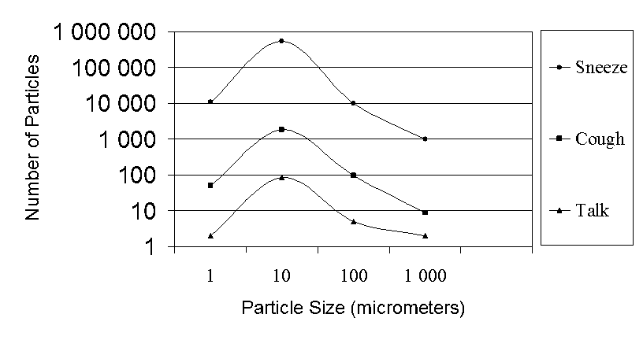
Particles Produced by Infected Persons
National Air Filtration Association; 2006 Rev. 2
Notes:
These experiments show that viruses can be transmitted to healthy individuals through the airborne route. Virus infected persons are a mobile contaminant source.
16

Slide 17
Microbial Indoor Air Pollution
mould
bacteria, viruses
pet hair, skin flakes, faeces, urine
insects (cockroach faeces, dust mites, etc.)
pollen
Outdoor sources: mould, pollen in outdoor air
Indoor sources - major concern:
- humidifiers and stagnant waters
- moist surfaces and materials
- vapour from showering
- air conditioning
- upholstered furniture and carpets
- animals (the allergens can be present months after the removal of the source)
- infected people

Slide 18
Causes of dampness/mould in the buildings
Rising dampness
The capillary-like absorption of groundwater into the structural elements of the building (bad insulation)
Penetrating dampness
leaking, rain, melted snow (through the roof, walls or joints)
Condensation
Excessive vapour production or inadequate ventilation
Inadequate heating
Cold surfaces

Slide 19
Health consequences of dampness/mould
in the buildings
Increased risk of - respiratory symptoms
- respiratory infections
- exacerbation of asthma
- development of asthma
- allergic rhinitis
- allergic alveolitis
- hypersensitivity pnemonitis
N.B.: Atopic and allergic people are particularly susceptible!
WHO Indoor Air Quality Guidelines on Dampness and Mould (2009)
„As the relationships between dampness, microbial exposure and health effects can not be quantified precisely, no quantitative, health-based guidline values or thresholds can be recommended for acceptable levels of microorganism contamination.
Instead, it is recommended that dampness and mould-related problems be prevented. When they occur, they should be remediated because they increase the risk of hazardous exposure to microbes and chemicals.”

Slide 20
An overview of the chemical pollutants

Slide 21
Combustion products
Combustion products:
Carbon monoxide (CO)
Nitrogen dioxide (NO₂)
Sulphur dioxide (SO₂)
Nitrogen oxides (NOx)
Particulates (PM)
PAH compounds
Sources:
Ambient air (traffic, power plants, industry)
    Heating, stoves and fireplaces
    Environmental tobacco smoke (ETS)
    Garages
    Parking lots nearby classroom windows
    Candles, sparklers and incenses
    Mosquito coils
Notes:
A large number of combustion products originate from various different sources. The main ones are listed here.
<<READ SLIDE.>>

Slide 22
Nitrogen-dioxide (NO₂)
I/O ratio ~ 0.8
Health effects: Asthmatics are especially sensitive (!)
Increased bronchial reactivity
Reduced respiratory function
Increased respiratory morbidity
Reduced immunological protection
Middle ear, nose-, ear-, pharynx inflammation
Increases the allergenic effect of allergens (e.g. Food allergy!)
Eczema
Increased blood coagulation in adults
Limit values:
WHO: indoor 1 hour: 200 µg/m³
annual: 40 µg/m³

Slide 23
Carbon monoxide (CO)
I/O ratio ~ 1.0
It is caused by incomplete combustion. Sources:
Heating and cooking devices
ETS
Running car engines in the garage!
Car traffic
Other outdoor CO sources (power plant, incinerator, industrial pollution)
CO binds 250 times stronger to haemoglobin than O₂. Foetal Hb also has a stronger affinity to CO. CO causes tissue hypoxia.

Slide 24
Carbon monoxide (CO)
Acute symptoms:
Headache, vertigo, tiredness, heavy breathing
Nausea, vomiting
Irritability
Drowsiness, confusion, desorientation
Loss of consciousness, coma
Death
Chronic exposure:
Ischemic heart disease, myocardiac failure, AMI
retardation in fetal development, reduced birthweight, congenital malformation
Increased cardiovascular and total mortality
Asthma, sinusitis, pneumonia
Increasing
COHb
concentration
Notes:
The route of exposure is through inhalation. Unintentional exposure to CO can be attributed to smoke inhalation from inadequately vented combustion appliances, and from vehicles and tobacco smoke.
The clinical features of CO poisoning are highly variable and symptoms vary from mild to very severe. Acute effects are due to the formation of carboxyhaemoglobin in the blood, which inhibits oxygen intake. At moderate concentrations, angina, impaired vision, and reduced brain function may result. At higher concentrations, exposure to CO can be fatal. Delayed neuropsychological sequelae have been reported in adults and children; these usually occur 3 to 240 days following exposure and are estimated to occur in 10 to 30% of victims.
Ref:
California Poison Control System. Poisoning and drug overdose. Olson ed. Appleton and Lange, 1999.
<<READ SLIDE.>>

Slide 25
Carbon monoxide (CO)
Taking sensitive populations into account (!)
WHO Guideline:
15 min.: 100mg/m³
1 hour: 35 mg/m³ (INDEX project: 30 mg/m³)
8 hours: 10 mg/m³
24 hours: 7 mg/m³

Slide 26
Ozone
At ground level ozone is not emitted directly, but it is created by chemical reactions between NOX and VOCs in the presence of sunlight and heat.
OZONIZERS – as air purifiers
Ozone is harmful to health
  Chest pain, coughing, throat irritation, airway inflammation, lung damage
The air purifying effect of ozone is ineffective in concentrations under the limit values
  WHO AQG for Europe (2nd ed.) 120µg/m³ (8 hours),
It is used in high concentrations to disinfect, deodor, or for chemical decontamination of spaces not intended for human staying.
Notes:
Ozone generators have become popular in some industrialized countries. Ozone is a molecule composed of three atoms of oxygen. The third oxygen atom can detach from the ozone molecule, and re-attach to molecules of other substances, thereby altering their chemical composition. Scientific evidence shows that, at concentrations that do not exceed public health standards, ozone has little potential to remove indoor air contaminants: there is no approval for its use in occupied spaces.
When inhaled, ozone can damage the lungs. Relatively small amounts can cause chest pain, coughing, shortness of breath and throat irritation. Ozone may also exacerbate chronic respiratory diseases such as asthma and compromise the ability of the body to fight respiratory infections. People vary widely in their susceptibility to ozone.
<<READ SLIDE>>
These notes are taken from the US EPA website www.epa.gov/iaq/pubs/ozonegen.html

Slide 27
Pollutants released indoors
Formaldehyde
Other Volatile Organic Compounds
Phthalates, polybrominated flame retardants, per- and polyfluorinated chemicals
Vinyl chloride
Trichloroethylene, tetrachloroethylene, ammonia
Terpenes (limonene, alpha-pinene)
Phenol
Naphthalene
Asbestos

Slide 28
VOCs
formaldehyde, organic solvents (benzene, xylenes, ethylbenzene, toluene, carbon tetrachloride, styrene), methylene, perchloroethylene, vinylchloride, benzene, toluene, xylene, aniline, terpenes (limonene, alpha-pinene), etc.
Concentrations of many VOCs are consistently higher indoors (up to ten times higher) than outdoors.
Sources:
paints, paint strippers and other solvents
wood products (formaldehyde)
varnishing
aerosol sprays
air fresheners, deodors, hair sprays
cleansers and disinfectants
pesticide
building materials and furnishings
office equipment (copiers and printers
glues and adhesives, permanent markers, highlighters, correction fluids
Health effects:
eye, nose and throat irritation
headaches, fatigue, dizziness, nausea
damage to liver, kidney and central nervous system
some organics are suspected or known to cause cancer

Slide 29
Formaldehyde
Sources:
Furniture
Wood products
Insulation (urea formaldehyde insulators - UFFI)
Disinfectant – preservatives (paints, varnishes, parquets, wallpapers)
Laminated and extruded plastic products (urea- and phenol-formaldehyde resins)
Polymers (polyacetates, melamine-resins)
Traffic (exhaust emissions)
Cigarette smoke
Acute health effects of exposure:
Mucous membrane irritation (lacrimation, sneezing, throatache, increased expectoration)
Inhibits ciliary activity
Skin irritation (rash, itching)
Allergenic, sensitizing effect
Sinusitis, headache, nausea, insomnia
Weak mutagenic effect, but synergism (UV, rtg)
Chronic health effects of exposure:
Chronic rhinitis, bronchitis
Bronchial asthma
Allergy
Carcinogen (IARC Group 1)
Emission increases with temperature and humidity!

Slide 30
Formaldehyde
Odour threshold:
10% = 30 µg/m³; 50% = 180 µg/m³; 90% = 600 µg/m³
WHO guideline: 100 µg/m³ – 30 minutes
Exposure reduction:
Reduced formaldehyde-emitting products
Temperature and humidity control
Proper ventilation

Slide 31
Benzene
Sources:
Varnishes, paints, adhesives
Cigarette smoke (430-590µg/cigarette),
Combustion, oil heating
Traffic (gasoline),
Garages
Oil industry
Chemical- and pharmaceutical industries
Health effect (less toxic with toluene) :
Acute poisoning: euphoria, nausea, vertigo, cramps, loss of consciousness, respiratory arrest
Chronic poisoning: haematological disorders (bone marrow anaplasia, leukaemia - IARC 1A carcinogen), chromosome aberrations, immunological disturbances, asthmatic symptoms

Slide 32
Benzene
Guideline values: No safe concentration (!)
US/EPA lifetime cancer risk:
1 µg/m³ = 2.2-7.8 / 1.000.000
WHO excess lifetime risk (leukaemia):
1 μg/m³ = 6 /1.000.000
0.17 μg/m³ = 1/1.000.000
1.7 μg/m³ = 1/ 100.000
17 μg/m³ = 1/ 10.000
WHO guideline value: 5 μg/m³ – yearly average

Slide 33
Toluene
Source: Chemical industry (to replace benzene!)
Health effects: liver and kidney damage, central nervous system damage (glue sniffers!), reproductive damage, disruption of foetal development (spontaneous abortion, developmental disorder, IUGR). Not genotoxic, not carcinogen
Guideline values:
WHO Guideline value:
260 μg/m³ (weekly avg. concentration)
(also good protective effect in terms of reproduction)
based on odour threshold: 1 mg/m³ (30 min avg)
Values measured in Hungary:
SEARCH: 4.7 ± 4.0 (1.0-21.4) μg/m³

Slide 34
Xylenes
Less toxic than benzene.
Acute effect: skin irritation
Chronic effect: liver and kidney damage
Values measured in Hungary:
SEARCH: 7.4 ± 12.4 μg/m³ (range: 0.4 – 69.3)

Slide 35
Naphthalene
Sources: coal tar, industry (phthalate production), car exhaust, moth repellents, disinfectants, deodorants
Health effect:
Respiratory damage (inflammation, cancer- in animals)
Carcinogen (IARC 2B) – possibly
Guidelines:
WHO IAQ Guideline: 10 μg/m³
values measured in Hungarian schools: 3.2 ± 2.1 (range: 0.3 -9.0)
Limonene
Source: Cleaning products
Values measured in Hungarian schools:
37.3 ± 41.8 μg/m³ (range: 4.9-149.5)

Slide 36
Trichloroethylene (TCE)
Sources:
ambient air (18 µg/day on average)
indoor air (woodstains, varnishes, coatings, lubricants and adhesives, paint removers, cleaning products)
drinking water (6 µg/day on average)
Health effects:
Toxic effect: - central nervous system (headache, tiredness, irritability,
alcohol intolerance, it was used as a general anesthetic)
- liver
- kidneys
Adverse pregnancy outcomes (spontaneous abortion (+/-), heart malformation)
Carcinogenic effect: IARC 2A category (probably human carcinogen), liver and biliary cancer (risk increase of 90%), non-Hodgkin lymphoma (risk increase of 50%), leukaemia, myeloma multiplex, cervical cancer, renal cancer (risk incease of 70 %)

Slide 37
TCE
According to WHO Air Quality Guideline for Europe , 2000:
NO SAFE CONCENTRATION (!)
Excess lifetime risk values: in case of 2.3 μg/m³: 1/1million, in case of 23.0 μg/m³: 1/100thousand,
in case of 230.0 μg/m³ :1/10thousand.
Based on this, the Hungarian limit value for ambient air is: 23 μg/m³.
Indoor spaces are not regulated. The expert opinion of NIEH/HU designated
11 μg/m³ as the level where intervention is necessary.
Concentrations measured in Hungarian schools (SINPHONIE):
9.7 ± 24 μg/m³ (range: 0.0 – 86.2 μg/m³)
Notes:
4/2004 (IV.7) KvVM-ESzCsM-FVM együttes rendelet a légszennyezettségi határértékekről, a helyhez kötött légszennyező pontforrásokkibocsátási határértékeiről szóló 14/2001. (V.9.) KÖM-EüM-FVM együttes rendelet módosításáról

Slide 38
Tetrachlorethylene
Source: clothes cleaning (service and detergent residue)
Exposure: inhalation
Health effects:
carcinogenic (IARC 2A, ie. Probably carcinogenic to humans)
nephrotoxic effect (derived guideline value: 250 μg/m³
NIEH/HU recommendation: 260 μg/m³
Concentrations measured in Hungarian schools:
SINPHONIE: 0.06 ± 0.26 μg/m³ (range: 0.0 – 1.0 μg/m³ )

Slide 39
Vinyl chloride
Source:
Vinyl chloride is produced in water under anaerob circumstances from trichlorethylene and tetrachlorethylene. It gets into the air where its half-life is around 20 hours. After it is inhaled it transforms into very reactive and mutagenic metabolites.
Health effects:
Its acute toxicity is low, but even in low concentrations (whether short or long exposure) it is toxic to the liver.
It is mutagenic, carcinogenic (IARC 1A, liver haemangiosarcoma and other tumors: liver tumour, brain tumour, lung cancer, and malignancy of the lymphatic and haematopoietic system. The liver is the most sensitive to VC exposure.

Slide 40
The different regulations contain the following limit values and guideline values for VC:
COUNTRY | μg/m³
Hungary: 4/2004. (IV.7.) KvVM-ESZCSM-FVM Joint Decree occupational limit value: 10 mg/m³ | 5 (annual)
The Netherlands, 1984, carcinogenic life-time unit risk: for10⁻⁶ | 0.35
EPA/IRIS carcinogenic life-time unit risk: 1 g/m³  4.4 x 10⁻⁶ from childhood: 8.8 x 10⁻⁶ | 0.23 (for 10⁻⁶) 2.3 (for 10⁻⁵) 0.11 (for 10⁻⁶) 1.1 (for 10⁻⁵)
WHO (1987) carcinogenic life-time unit risk: 1 0g/m³  1.0 x 10⁻⁶ | 10 (for 10⁻⁵)
WHO, Geneva, 2000 as above

Slide 41
Endocrine disrupting chemicals
Phtalates (plasticizers in soft plastic and gum objects)
Polybrominated flame retardants, BFRs (PCBs, PBBs, PBDEs) (plastic, electrical and electronic equipment, upholstered furniture, curtains, blinds)
Per/polyfluorinated water- and stain repellents, PFCs (PFOSs, PFOAs, PFCAs) (carpets, upholstery stain-protectants, carpet-care liquids, treated home textiles, floor waxes)
Pesticides (see next slide)
Polycyclic aromatic hydrocarbons (PAHs) (in ambient air by incomplete combustion of organic matter, smoke, diesel exhaust)
Higher concentrations of phthalates, BFRs, PFCs in newly constructed or renovated buildings.
Most of them are very stable, persistent and bioaccumulating chemicals.
Molecules from consumer products spread into indoor air, dust and indoor surfaces.

Slide 42
Endocrine disrupting chemicals
Health effects (through disturbing the normal hormonal functions):
reduced semen quality with consequent decreased fertility, genital malformations, testicular and prostate cancer
early puberty, cysts in the ovaries, endometriosis, decreased fertility, pregnancy complications with early abortions, breast cancer
diabetes and obesity
disorders in brain development (ADHD, ASD), and degenerative diseases in the brain (Parkinson’s disease)
Hyper- and hypo- thyroidism and thyroid tumours.

Slide 43
Pesticides
(insecticides, herbicides, rodenticides, etc.)
Problems arising from the indoor use of pesticides:
Greater concentration near the floor
They stay longer on certain surfaces (e.g. carpets)
Sometimes too frequent, too extensive and in some cases unnecessary application
Insecticide types commonly used indoors:
Pyrethroids: allergens, damage central nervous system (in large concentrations)
Cholinesterase inhibitors: neurotoxins, inhibit the neuro-development
Hydramethylnone (relatively new)
Insect repellants
Mosquito coils
Health effect:
Acute poisoning – usually accidental
Allergic and general symptoms are frequent due to inhalation
Long term pesticide exposure has been linked to the development of asthma? central neural system disorders (attention deficit and hyperactivity disorder, ADHD) and degenerative diseases (Parkinson’s disease); cancer (leukaemia, non-Hodgkin lymphoma)
Notes:
Spraying pesticides in the home results in increased risks to children because of higher concentrations near the floor and persistence of insecticides in carpets and soft toys. The typical activities of young children also contribute to their higher exposure.
Pesticides are covered extensively in a separate module.
Ref:
Reigart. Pesticides in children. Pediatric Clinics of North America, 2001, 48:1185.
Children are exposed to a wide range of pesticides, including insecticides, herbicides, fungicides and rodenticides. They differ from adults in their exposures and responses to exposures. Acute and chronic toxicity are discussed, and important chronic effects, such as carcinogenesis, endocrine disruption, and neurodevelopmental effects are reviewed. Laws and regulations are also discussed. Recommendations are made to pediatricians regarding treatment and advising families regarding avoidance of pesticide exposures and their effects.

Slide 44
Asbestos
Types : chrysotile (white asbestos) (90-95%)
crocidolite (blue asbestos)
(amosite – brown asbestos) tremolite, actinolite, anthophyllite
Dangerous: > 5 µm long and <3 µm wide fiber
length / width > 3
Exposure:
Mining, construction, oil refineries, automotive industry, paper production, rubber industry
During the production of asbestos textiles (PPE, sealants), friction pad production, seals, (automotive industry), thermal insulation, flame retardants (buildings, vehicles, heaters), spraying technology, during the installation of filters (food industry, air purifying), through the usage of additives (paper production, rubber industry), contamination (talcum).
Corrugated and flat roofing sheets, pipes transporting air, gas, water, wastewater
In Hungary approx. 200,000 people got exposed to asbestos

Slide 45
Asbestos
Prevention:
Legislation: ban
Limit value: NO SAFE CONCENTRATION
acceptable risk (10⁻⁵ – 10⁻⁶): WHO: 1000 F/m³ lifetime exp.
The built-in asbestos, until it is in a good condition, is better left alone
Removal has to be done by experts and with appropriate protection!
Has to be treated as hazardous waste after removal

Slide 46
Contribution of indoor air pollution to the disease burden
The annual burden of disease caused indoor air pollution, including polluted outdoor air used to ventilate indoor spaces, is estimated to correspond to a loss of over 2 million healthy life years in the European Union (EU).
These estimates are calculated as disability adjusted life-years (DALY) and account for loss of life years due to premature mortality and due to years lived with disabilities (i.e. morbidity).

Slide 47
DALY (Disability-Adjusted Life Years)
DALY is the sum of Years of Life Lost (YLL) due to premature mortality
and the Years Lost due to Disability (YLD) for people living with the health condition or its consequences. (WHO)

Slide 48
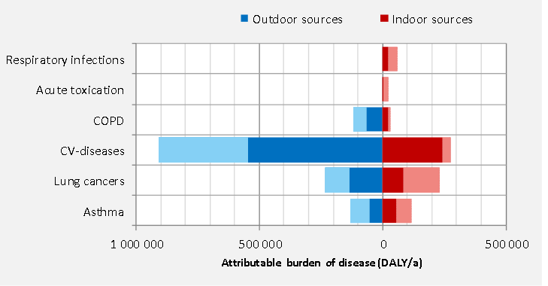
Attributable burden of diseases due to indoor exposures in 2010 in EU26.
The lighter shade represents the maximum reducible fraction

Slide 49
The contribution of indoor air pollution
to the European symptom- and burden of disease
(x 1000 DALY/year) not including environmental tobacco smoke
Source: ENVIE Final Report, 2008
DALY: Disability-adjusted life years

Slide 50
Contribution of indoor air exposure to the European symptom- and disease burden (x 1000 DALY/year),
not including environmental tobacco smoke
DALY: Disability-adjusted life years
Source: ENVIE Final Report, 2008

Slide 51
Contribution of inadequate IAQ to the European symptom- and disease burden (x 1000 DALY/year, %), not including environmental tobacco smoke
Source: ENVIE Final Report, 2008
DALY: Disability-adjusted life years

Slide 52
Building with known problems
Sick Building Syndrome
Sick Building Syndrome
People staying inside experience acute health and comfort effects that are apparently linked to the time learning/teaching/working indoors
Building-Related Illnesses
A relatively small number of people staying inside experience health problems accompanied by physical signs that are identified by a physician and/or laboratory findings, and can be attributed to environmental agents in the air

Slide 53
Sick Building Syndrome vs.
Building-Related Illness
Sick Building Syndrome building related non-specific symptoms
Headaches
Fatigue
Irritated eyes, nose, throat and/
or skin
Dry mucous membranes dry or itchy skin
Hoarseness of voice and wheezing
Difficult to trace to a specific source.
Symptoms clear when away from building .
Building-Related Illness recognized building related diagnoses
infection
Legionnaires’ Disease
Aspergillosis (immune- compromised)
cold, flu
allergic reaction
asthma,
rhinitis
The cause is clearly related to the building.
Symptoms may not clear upon leaving the building.
Notes:
53

Slide 54
Causes of SBS
Causes may originate during planning and construction or during operation, maintenance and usage.
It is difficult to find the cause in individual cases.
The problems can be sorted into 4 categories (WHO):
- local factors
- construction materials, equipment, problems connected to the function of the building (chemical release of construction materials and furniture, lighting, heating)
- problems independent of the structure of the building (dust-, mould-, or pollen allergy)
- psychological problems (societal, physical attributes and other factors)

Slide 55
Frequent (not exclusive) attributes in sick buildings (WHO)
(Not every sick building has all of them and not every building is sick where the following occur.)
Building was constructed after 1960
Air-conditioned building, windows can’t be opened
Very bright and/or flickering lights
Ventilation, heating, lighting can be insufficiently controlled
Carpets or upholsteries with a large surface
Many open shelves or storage compartments
New furniture, carpet or painted surface
Neglected maintenance, insufficient cleaning
High temperatures or large temperature fluctuations
Very low or very high humidity
Chemical pollutants (cigarette smoke, ozone) or VOC from building materials, equipment
Particulate matter and fibers in the air
Computer monitors

Slide 56
Prevention
PLANNING
- are there hidden problems at the building site? (e.g. High ground water, radon, other contamination)
- every potential risk factors should be taken into consideration (proper ground plan, cleaning properties, appropriate heating factors)
- what is the quality of the local ambient air? If it is bad, was this taken into consideration in the planning of the ventilation and insulation?
OPERATION
Ventilation: bad ventilation (inadequate ventilation or draught) is a frequent cause of SBS
Cleaning: the contamination of surfaces is a frequent cause; hidden nooks; damp places; ventilation equipment, filters, grating etc., cleaning properties
Comfort factors:
- noise (from the equipment, ventilation system etc.)
- high temperature (>21ºC), fumes, microorganisms, RH
- lack of natural lighting

Slide 57
Indoor Environmental Quality (IEQ)
IEQ - Indoor environmental quality is a general indicator of the quality of conditions inside a building.
IEQ = good quality performance in indoor air quality + thermal comfort + daylight, lighting and views (visual conditions) + acoustic conditions + electromagnetic frequency levels
Home, work, school, car…all are indoor environments
Notes:
57

Slide 58
Indoor Environmental Quality (IEQ)
Ventillation
Chemicals
Ventillation
Feeling
at learning,
teaching
Thermal
confort
Biological
agents
Lighting,
noise,
EMF
Individual
sensitivity,
vulnerability

Slide 59
Factors influencing IAQ
V(dC_{i}/dt)=P-E-Q(C_{i}-C_{o})
where
V = the total volume of indoor air space (m³),
C_{i} is the indoor concentration of the pollutant (µg/m³),
P is the emission rate of the pollutant (µg/h),
E is the hourly elimination rate of the pollutant through chemical reaction, surface binding, filtering, or deposition (µg/h),
Q is the air exchange rate between the outdoor and indoor space (m³/h) and
C_{o} is the outdoor concentration of the pollutant (µg/m³).

Slide 60
The role of air exchange in IAQ (ventilation)
Providing fresh air
Removing accumulated pollutants, diluting their concentration
Reducing temperature
Hygienic aspects of ventilation:
Air movement aids evaporation, and thus usually has a cooling effect on the body. A lack of air movement leads to damp problems and has a negative effect on metabolism and the thermal state of the body: can cause feelings of discomfort and exhaustion.
The feeling of draught limits ventilation: air velocity beyond 0.3-0.5 m/sec is perceived as draught and could result in cooling of the body or parts of the body.
The IAQ guidance values should not be reached primarily through ventilation, but by reducing emission

Slide 61
Ventilation Measurement
In naturally ventilated buildings
By Infiltration measurement. Infiltration is measured as air change per hour (ACH) – the average rate at which indoor air is replaced by fresh outdoor air.
ACH is a rough index for different building conditions.
ACH is 0.1 to 0.2, in “leaky building”, ACH is 2.0 to 3.0 in normally ventilated buildings
Tracer gas technique is applied to measure infiltration. Non reactive gases are used with the assumption that the loss of tracking gas is only due to ventilation / exfiltration.
In mechanically ventilated buildings
ACH is measured by CO₂ concentration.
Notes:
61

Slide 62
Fresh air demand / 1
In the inhaled air: 21% oxygen, 0.03% carbon dioxide
(78% nitrogen, 0.97% inert gases)
In the exhaled air: 16% oxygen, 3-5% carbon dioxide + water vapour
Indicative importance of CO₂ concentration:
0.1% CO₂ perception of stuffy air
1% CO₂ discomfort/malaise,
10% CO₂ life threatening
According to the CEN Report CR 1752 (1998 Dec):
CO₂ outdoor typically 350 ppm=700 μg/m³
category A: outdoor CO₂ + 460 ppm (15% dissatisfied)
category B: outdoor CO₂ + 660 ppm (20% dissatisfied)
category C: outdoor CO₂ + 1190 ppm (30% dissatisfied)
CO₂ concentration is generally used as an indication
of the efficiency of ventilation

Slide 63
Fresh air demand / 2
Fresh air demand is influenced by
occupancy, activity (10-12x in case of physical work)
age, state of health, size and function of the premises
N.B.! There are other than just CO₂ producing/emitting pollution sources!
According to the CEN Report CR 1752 (1998 Dec):
Required ventilation in classrooms for comfort:
Category A: 6.0 litre/sec (l/s) per m² floor area
Category B: 4.3 l/s per m² floor area
Category C: 2.4 l/s per m² floor area

Slide 64
Fresh air demand / 3
Person-related ventilation rate:
Standards on fresh air demand of building rooms according to fresh air need of persons:
Average classroom condition: 2m²/person → 6m³/person
The total air should be exchanged min. 3-6 times /hour
Insufficient natural ventilation causes increased moisture/mold, enhanced concentration of bacteria/viruses/fungi and chemical pollutants, as well unpleasent odors.
Ventilation methods:
Natural ventilation (windows or vent-holes)
Mechanical ventilation (with fans)
fresh air demand ≈ 15-36 m³/person/hour

Slide 65
Natural ventilation
Infiltration: random/ intentional flow of outdoor air through windows, cracks and different openings in the buildings.
Exfiltration: movement of air from indoor to outdoor.
Natural Ventilation
Air Flow- occurs mainly due to two gradients:
- Pressure – difference between outdoor and indoor pressure
- Temperature - when the inside air temperature differs from outside one
Natural ventilation in general inefficient as it is not uniformly distributed. Air doesn’t circulate evenly and stale air remains in some spaces.
It transfers pollen and other contaminants from ambient air.

Slide 66
Mechanical ventilation
Involves use of fans and or air-conditioning equipments.
Main points of mechanical ventilation:
pulling fresh air from outside to indoor
transfer stale air to outside
adjusting temperature and humidity inside.
Heating, Ventilation, Air Conditioning (HVAC) systems:
Functions:
Heating - cooling
Ventilation
Filtration
Humidification - dehumidification
Air-flow
Parameters:
Infiltration air
Exfiltration air
Air-recirculation

Slide 67
Hygienic aspects of ventilation
Air movement helps evaporation, has a cooling effect on the body. A lack of air movement leads to damp problems and has a negative effect on metabolism and the thermal state of the body: can cause feelings of discomfort and exhaustion.
The feeling of draught limits ventilation: air velocity beyond 0.3-0.5 m/sec is perceived as draught and could result in cooling of the body or parts of the body.
The IAQ guidance values should not be reached primarily through ventilation, but by reducing emission.
CO₂ concentration is generally used as an indication of the efficiency of ventilation. Outdoor CO₂ concentration: ~ 400 ppm. Several guidelines recommend/accept 800 ppm indoors

Slide 68
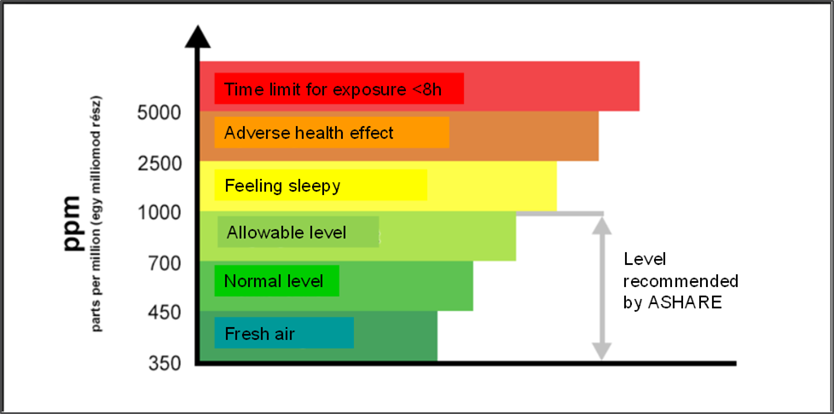
Relationship between indoor CO₂ concentrartion and health risks

Slide 69
Overall effects of poor indoor air quality
in underventilated/overcrowded classrooms
CO₂↑ ►concentration↓, decreased attention, test performance↓, fatique, headache, increased risk of accidents
Bacteria, viruses↑ ► infectious diseases, absenteeism
Humidity, temperature ↑, odor ► discomfort, headache
Moderately increased concentration of indoor released chemicals
► mild short-term symptoms (asthmatic symptoms, headache, fatigue, dizziness, nausea)
► long-term negative impact on central nervous system, respiratory system, cardiovascular system, hormonal system and contribution to later development of cancers)

Slide 70
Health effects of exposure to indoor air pollutants in children /1.
Impacts on respiratory system
Acute effects:
Mucous membrane irritation (eyes, upper respiratory tracts)
Coughing (bronchitis symptoms)
Wheezing, attacks of dyspnoe (heavy breathing) (asthmatic symptoms)
Increased responsiveness of the respiratory tracts to allergens
Increased acute respiratory morbidity (upper- and lower respiratory airway infections)
Chronic effects:
Decreased lung function
Contribution to later pulmonary diseases (COPD, malignant tumours)
Impacts on cardiovascular system
Elevations in arterial blood pressure and heart rate
Increased levels of stress hormones

Slide 71
Health effectsa of exposure to indoor air pollutants in children /2.
Impacts on immune system
Increased risk of infections (pneumonia, otitis media)
Absenteeism from school due to sore throat, cough, and cold
Increased levels of biomarkers of oxidative stress and inflammation
Impacts on central nervous system
Acute effects:
Headache, fatigue, dizziness, nausea
Impaired task performance
Chronic effects:
Impairments in different neuropsychological development outcomes (cognitive and psychomotor development delays, global IQ, learning disabilities, reading comprehension, memory functions, reading and maths scores, reaction speed, attention, coordination)
Changes in brain white matter, gray matter and basal ganglia assessed by neuroimaging methods were associated with air pollution
Prenatal and early childhood exposure can result in neurodevelopmental diseases (attention deficit/hyperactivity, autism spectrum disorders, etc.)

Slide 72
Health effects of exposure to indoor air pollutants in children /3.
Cancer inducing effect
childhood leukaemia, and some central neural system tumors in children are associated with certain air pollutants
childhood exposures may contribute to the development of other cancers in the later life as well
Endocrine disrupting effects of some chemicals
Impairments on reproductive system
Disorders in brain development
Contribution to later diabetes and obesity
Contribution to later hyper- or hypo- thyroidism

Slide 73
Effects of increasing ventilation rates in classrooms on task performance of pupils
Ventilation rate increase (l/s per person) | Effect on performance | Reference
1.5 → 13.0 | Increased speed by 5% on cognitive performance tests | Coley and Greeves, 2004
3.0 → 8.5 5.2 → 9.6 | Test speed significantly improved in 50% of tests | Wargocki and Wyon, 2007
0.5 → 13.0-16.0 | Increased pupils’ speed by ~7% in maths | Bakó-Bíró et al., 2012
3.0 → 9.5 | Improved speed by 8% on numerical and language based tests | Wargocki and Wyon, 2013
Prospective studies on long- term academic performance of pupils:
0.9 → 7.1 | Standardized tests increased by 2.9% for math and 2.7% for reading |  | Haverinen-Shaughnessy et al., 2010
each 10% increase in prior 30-day VRs | Increases of 0.6 points on English and Math tests |  | Mendell et al., 2016

Slide 74
Optimal ventilation - future perspectives
“Build tight and ventilate right” principle: ensure that air exchange and distribution within the building is sufficient
Plan the building envelopes:
  Tight building envelopes are essential for meeting the increasing demand of energy efficiency.
  This increases the risk of too low ventilation rates and consequently increased contaminant concentrations and moisture damage.
Clean the air and the ventilation system
Control the ventilation system according to the outdoor air temperature

Slide 75
Lighting
Architectural design has a direct impact on office lighting; geometry of windows, photometry of surfaces, amount of glazing etc., all have an impact on the illumination levels in a work area in schools as well
Illumination level : the standard requires a minimum illuminance of 150 lx in rooms with demands of good visual communication.
Vertical light on the wall, 300 lx, provides good ambient light. Indirect light on the ceiling, 300 lx, also provides good ambient light by which students are more alert and perform better
Direct light: minimum illuminance of 500 lux
Notes:
Visual comfort is very important for well-being and productivity of the occupants in buildings.
Preference for windows and beneficient impact of natural views is well established.
Architectural design has a direct impact on office lighting
Several visual comfort criteria such as view type, view quality and social density have an impact on physical and psychological health of the occupants
Geometry of windows, photometry of surfaces, amount of glazing etc., all have an impact on the illumination levels in a work area
Therefore, one needs to study daylight, artificial lighting, glare and visual comfort together in order get a more complete picture.
There is a direct relationship between acoustic comfort and occupant productivity in buildings.
Acoustic problems emanate from airborne sounds, outdoor noise, noise from adjacent spaces, noise from office equipment and sound of nearby facilities.
The level, the spectrum, and the variation with time of the noise may influence the level of disturbance.
Acoustic problems therefore need to be addressed at the design stages of the building. In order to address acoustic problems at design stages itself, it is important to assess what is going to happen indoors and outdoors.
75

Slide 76
Acoustic conditions
For noise recommendations are: ensure that all noise sources (e.g., ventilation systems, office equipment and street noise) do not exceed 40 dBA.
Tones are an annoying aspect of sound
Low frequencies below what are considered normal audio ranges have an impact on healthy hearing

Slide 77
Electromagnetic field
Electro-magnetic fields are fields of natural or induced magnetism.
Frequency: typical alternating current electricity is provided at 50 Hz.
Electronic equipment may change the frequency (e.g. computer screens).
Typical exposures are usually below 1 milliGuass (mG) or 0.1 microTeslas (μT).
EMF exposure levels
computer screen (30 cm away) < 0.01 μT
hair dryer (at source) 6 – 2000 μT
TV (~ 1 meter away) 0.01 – 0.15 μT
Electric shaver (at source) 15 – 1500 μT
Source: https://www.who.int/peh-emf/about/WhatisEMF/en/index3.html
Notes:
Electromagnetic fields (EMF) are generated by forces associated with electric charges in motion, and by microwaves, radio waves, electrical currents, and transformers.
Electromagnetic fields of all frequencies represent one of the most common and fastest growing environmental influences, about which concern are growing. All populations are now exposed to varying degrees of EMF, and the levels will continue to increase as technology advances.
Public exposure regulations in most countries continue to be based on the guidelines of the International Commission on Non-Ionizing Radiation Protection and Institute of Electrical and Electronics Engineers.
Laboratory studies confirm in vivo biological effects, namely chronic exposure has been associated with increased oxidative stress and DNA damage and cancer risk.
Currently insufficient evidence to prove that EMF would cause cancer.
77

Slide 78
Temperature
The increase of outdoor and consequently indoor air temperature in school buildings decreases the vigiliance of children.
  The complaints for headache, fatigue, and feeling very hot correlate with the increase of indoor temperature.
Energy efficiency and increase of weather resilience (sealing and insulating), air conditioning moderates temperature changes, contributes to save energy.
  On the other hand sealing and tightening the building can make existing problems worse, create new problems which can cause discomfort

Slide 79
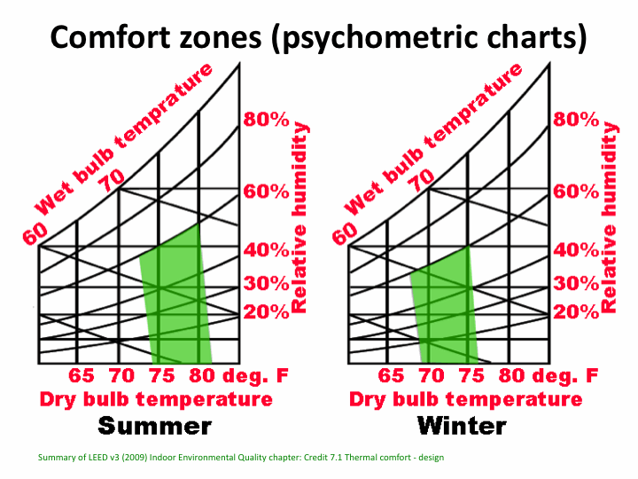
Thermal comfort
Human Thermal Comfort: function of both temperature and relative humidity
Factors influencing on thermal comfort
Environmental
  Air temperature
  Humidity *
  Air movement/velocity (m/s)
  Radiation (Mean radiant temperature)
Personal
  Activity
  Clothing
*RH: Ratio of the amount of moisture present in the air to the maximum amount which it can hold at saturation at a given temperature
http://www.suryakund.com

Slide 80
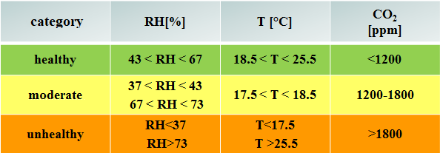
Factors defining indoor comfort
Factors
Temperature: ideal in the range of 18,5 – 25,1 °C
Relative humidity: ideal 43%< RH <67 %
CO₂: ideal < 1200 ppm
Ranking the health impact of comfort factors

Slide 81
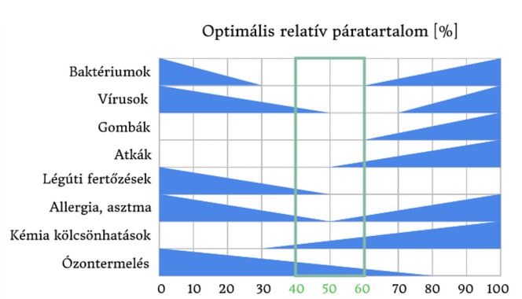
Optimal relative humidity in relation to selected pollutants and health risks
Optimal relative humidity %
Bacteria
Viruses
Fungi
Mites
Airway infections
Allergy,
Asthma
Chemical interactions
Ozone production
Optimal range for humans

Slide 82
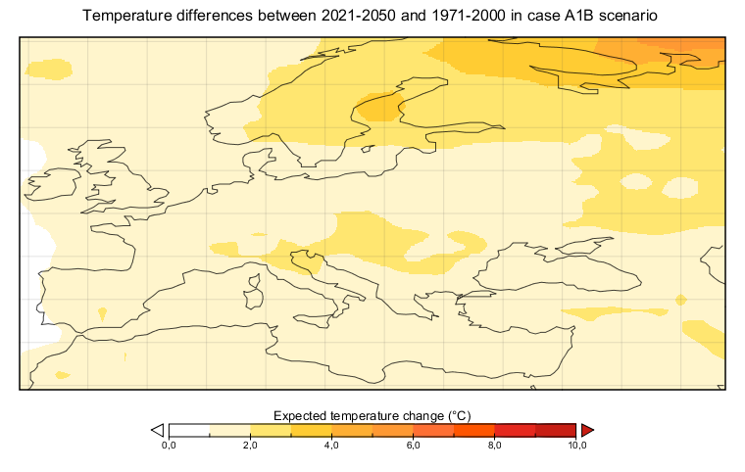
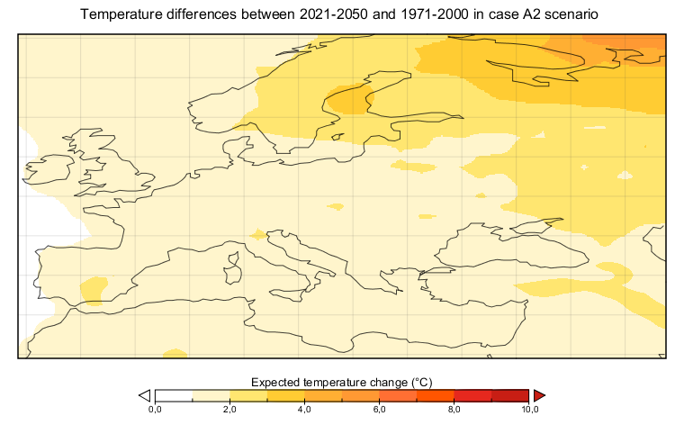
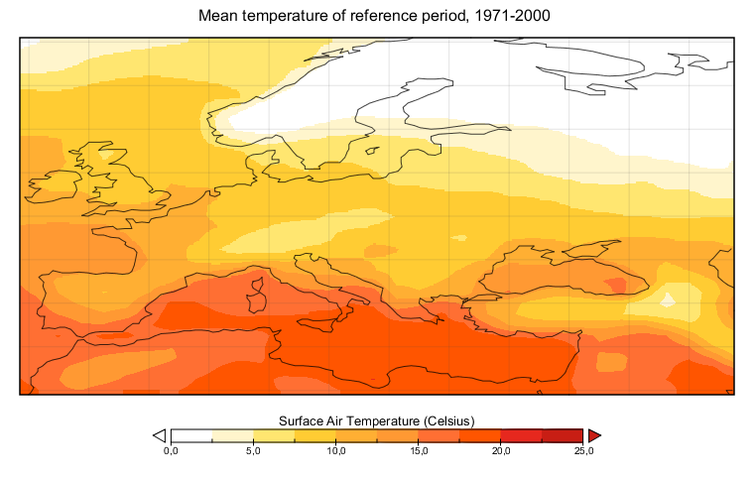
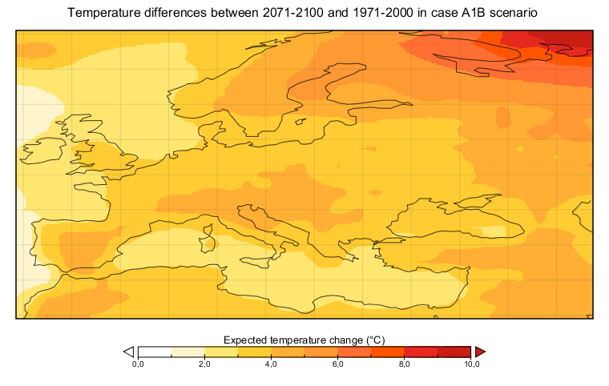
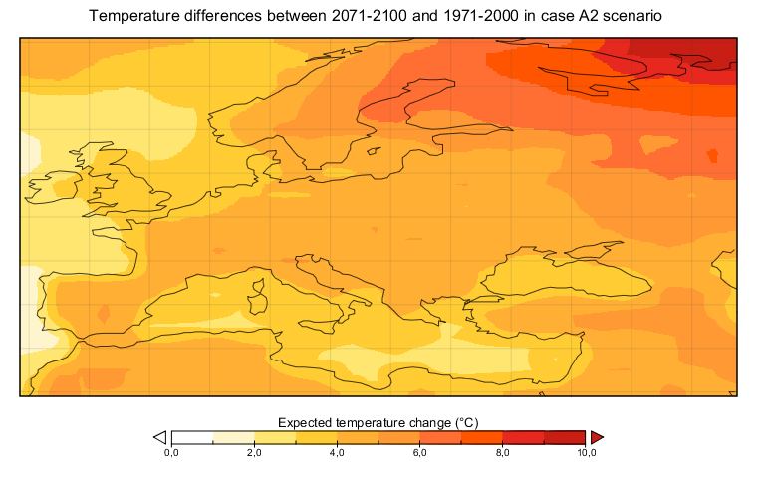
Mean temperature and temperature differences of Europe in the reference , near and far future periods by A1S and A2 emission scenarios

Slide 83
Climate change
Resiliance
Temperatures in Europe will keep rising with time in future. The peak rise in summer can be up to 5 C from the present peak temperature.
The internal temperatures in class rooms will increase with rise in future exterior temperature.
The percentage of occupied hours under thermally comfortable condition (below 24 °C) during (pre)summer season will decrease and risk of overheating (above 28 °C) will increase with time in future in the classrooms.
The internal temperature will be generally higher than the external temperature due to high internal heat gains from occupants, lights and other electrical equipments used inside.

Slide 84
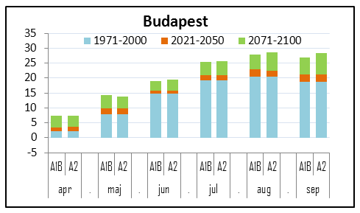
Predicted monthly mean temperature increase by A1B and A2 emission scenarios in Budapest

Slide 85
Climate change
Air quality
Weather, climate change determines the development, transport, dispersion and deposition of air pollutants.
Exposure to elevated concentrations of ozone is associated with increased hospital admissions for pneumonia, chronic obstructive pulmonary disease, asthma, allergic rhinitis and respiratory diseases, and with premature mortality.
The concentration of fine particulate matter (PM) depends, in part, on temperature and humidity. The health impacts of PM is stronger than that for ozone. PM is known to affect morbidity and mortality, so increasing concentrations would have significant negative health impacts.

Slide 86
Climate change health risks for schoolchildren
Risk of accidents
The first days of summer, there is an increase in the number of summer-related accidents and injuries.
A direct association between trauma attendance and weather was found with higher attendances on dry and sunny days.
Admissions of children with fractures admitted to hospital strongly correlated with mean monthly sunshine hours.
Accidents risks of children, are connected to different activities at home, at school and in afternoon leisure time, calling the attention that the projected increase of temperature may pose a significant risk for schoolchildren

Slide 87
Problems of contemporary buildings* 1.
Contemporary design schools have higher risk of overheating in both present and future conditions.
This can be explained by not only less internal thermal mass but also higher window to wall ratio in building envelope.
Higher window to wall ratio can lead to higher solar gains in internal spaces in absence of solar shading devices.
Dasgupta A, et al. HVAC&R RESEARCH 2012;(18)1,2.
DOI: doi.org/10.1080/10789669.2011.614318

Slide 88
Problems of contemporary buildings 2.
Energy efficient schools, which also have shaded windows with highly insulated building envelope also lack in providing better thermal conditions inside as they lack in adequate internal thermal mass which can be used for passive night cooling that helps in improving day time thermal conditions.
Also, the insulation of the envelope in such schools not only prevents heat loss during winter but also retains internal heat generated by pupils and electrical equipment during summer.

Slide 89
Problems of contemporary buildings 3.
It is observed that naturally ventilated passive design schools are and will be most thermally comfortable followed by energy efficient schools. This can be explained by the better ventilation strategies and high internal thermal mass adopted in their design.
The energy efficient schools, even after having insulated building envelope, well shaded windows and ample ventilation, lack in providing adequate thermal comfort because of less internal thermal mass.

Slide 90
Interventions and measures suggested 1.
The risk of overheating in schools can be reduced if more exposed internal thermal mass is used with night cooling/purge ventilation which helps in absorbing the heat generated inside classrooms even when the external temperature is higher than thermal comfort limit.
By insulating building fabric from outside will also help improve thermal resistance of building envelope to prevent external heat gains and maintain existing thermal mass to use night time cooling.

Slide 91
Interventions and measures suggested 2.
School buildings with high window to wall ratio can be upgraded by using insulated glazing panels and external shading devices to prevent solar and conductive heat gains through windows. Low-E coatings on glazing can significantly reduce direct and indirect infrared radiations, especially where external shading is difficult to provide.
Reducing internal heat gains can also be a useful strategy to provide thermal comfort for pupils. This can be achieved by using energy efficient luminaries, lighting strategies and electrical equipment.

Slide 92
Take home messages for architects
Indoor Air Quality refers to the quality of the air inside buildings as represented by concentrations of pollutants and thermal (temperature and relative humidity) conditions that affect the health, comfort, and performance of people staying inside.
The internal temperatures in class rooms will increase with rise in future exterior temperature. Therefore thermal resistance of building envelope should be improved together with reducing internal heat gains. This can be achieved by using energy efficient luminaries, lighting strategies and electrical equipment.
Good IAQ is the guarantee of comfort, health and safety
Growing children are very sensitive to hazardous chemicals

Slide 93
Potential ways of reducing indoor air pollution
Reducing emissions (qualified construction- and covering materials, using cleaner energy and better equipment)
Better planning (modern heating systems, appropriate construction- and covering materials, etc.)
Improving ventilation (chimney, exhausters, windows, ventilation holes, ventilation systems). Note that natural ventilation don’t guarantee the minimum air exchange especially in cities.
  The future solution is mechanical ventilation – HVAC- a way to sustaianble InAIRQ
BUT
Improper maintenance, design, and functioning of HVAC systems contributes to an increased prevalence of SBS symptoms.

